Slide 1
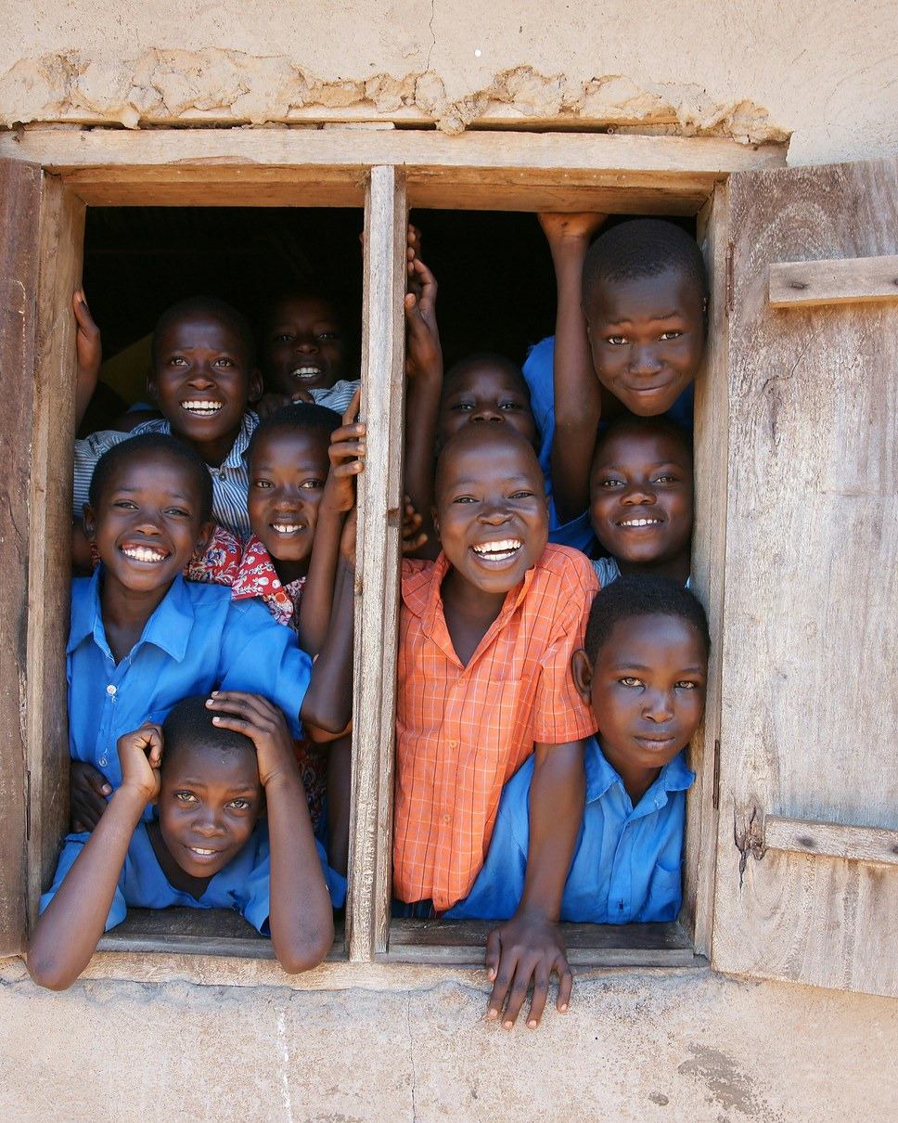
Student
Development
Programme
EMPOWERED FUTURE AFRICA (EMFA)
PROGRAMME OVERVIEW
An Empowered Future Starts Now.
Presented by Oluwatomisin Popoola
www.empoweredfutureafrica.org
Notes:
Opening hook: Nearly 105 million Nigerian children and adolescents are growing up in a system that rewards passing exams. EMFA's L.E.A.P programme teaches them to think, lead and solve problems, in 4 stages and 8 modules, ending in a community solutions showcase.

Slide 2





Who is EMFA?
Education-focused. Evidence-led. Starting in Nigeria.
MISSION
FOUR FOCUS AREAS
Advancing opportunities for children in underserved communities, starting within Nigeria.
BELIEF
Foundational Learning
Digital Skills
To improve education, we must first understand the conditions children learn in, the experiences that shape them and the opportunities available to them.
Personal Development & Community Impact
Research, Policy & Advocacy
Notes:
EMFA works across four areas: foundational learning, digital skills, personal development and community impact, and research, policy and advocacy. This programme sits in personal development and community impact.

Slide 3



The Problem We Saw
Nearly 105 million Nigerian children are in a system that teaches them to pass, not yet to think, lead and solve.
105M
Learning to pass exams, not to think critically
children and adolescents aged 0–17
Facing bullying and peer conflict without life skills to navigate it
~1 in 2
Academically engaged, but under-exposed to real-world skills
Nigerians is a child or adolescent
The gap: critical thinking · self-awareness · contribution to society → Our answer: the EMFA programme
Source: Federal Government of Nigeria and UNICEF, Situation Analysis of Children and Adolescents in Nigeria (2024).
Notes:
The 2024 Situation Analysis by the Federal Government and UNICEF puts Nigeria's children and adolescents at nearly 105 million, about half the population. Formal schooling reaches most of them, but exam-focused learning leaves a gap in critical thinking, self-awareness and contribution to society.

Slide 4
How Will We Solve It?
Beyond the Classroom: an extracurricular initiative for secondary school students
Skills, attitudes and practical abilities that support academic learning, personal growth and participation in society.
Learn
Practise
Showcase
Interactive sessions, teamwork and guided reflection
Hands-on projects that build communication and problem-solving
The Grand Finale: the Inter-School Community Solutions Challenge
Notes:
Beyond the Classroom is an extracurricular initiative. Students learn through interactive sessions, practise through hands-on projects, and showcase their work at the Inter-School Community Solutions Challenge.

Slide 5


L.E.A.P
FRAMEWORK
Learn.
Evolve.
Act.
Participate.
Helping students recognise their potential, strengthen essential skills and contribute meaningfully to their schools and communities.
Proposed pilot Ido–Apata axis, Oyo State, Nigeria
Notes:
L.E.A.P stands for Learn, Evolve, Act, Participate. The proposed pilot is in public secondary schools around the Ido–Apata axis in Oyo State.

Slide 6
Why This Programme Matters
The data behind the need
NATIONAL FIGURE
NATIONAL FIGURE
PROGRAMME DESIGN
67.2%
80%
8
of secondary students have experienced bullying in school
of Nigerian youth lack the digital skills the economy needs
integrated learning modules in the EMFA curriculum
Employers also report a 60% gap between expected and actual graduate skills.*
National figures describe Nigeria's wider education challenges, not findings from the pilot schools; the programme figure is design, not an impact result. Sources: bullying (67.2%) and digital skills (80%): source to be added. *Graduate skills gap (60%): Palladium, "Digital Skills are Key to Youth Unemployment in Nigeria" (2020), survey of 600 employer managers.
Notes:
Be clear with the audience: the first two figures are national, not findings from the pilot schools. The third is a design fact about the curriculum. Source for 67.2% and 80% still to be confirmed before external distribution.

Slide 7
The L.E.A.P Framework
A 4-stage journey: from learning in the classroom to leading in the community
P
A
Participate
E
Act
Contribute constructively to school and community life.
L
Evolve
Practise communication, collaboration and initiative.
Learn
Build self-awareness and reflect on personal growth.
Understand concepts, ask questions and examine evidence.
Notes:
Each stage builds on the last: Learn, Evolve, Act, Participate. Students move from understanding themselves to making a difference in their community.

Slide 8
Eight Learning Modules
8 practical modules across 4 connected stages of student development
01
02
03
04
Understanding myself and learning
Communicating and relating to others
Thinking and working together
Participating and solving problems
1. Knowing Myself and Knowing I Matter
3. Voice, Communication and Expression
5. Critical Thinking and Responsible Decisions
7. How My School and Community Works, and Where I Fit In
2. Learning with Purpose
4. Relationships, Respect and Belonging
6. Leadership, Teamwork and Initiative
8. How to Find a Problem Around Me and Create a Simple Solution
Notes:
Four stages, two modules each. Stage 04 is where students apply everything to a real school or community problem.

Slide 9
How the Sessions Will Be Conducted
Six steps from school entry to recognition
01
Engage
02
Learn
03
Team activities
Introduce EMFA to school leadership, understand the context and engage students.
Deliver L.E.A.P modules through discussion, group tasks, reflection and practice.
Groups identify a concern, gather information and develop possible responses.
04
Select
05
Compete
06
Celebrate
Teams are shortlisted against clear criteria: relevance, evidence, feasibility and clarity.
Teams present findings and solutions to judges, fellow students and invited stakeholders.
Recognise effort and promising ideas, and document lessons from the programme.
Notes:
Step 04 (selection criteria) is a proposed wording: confirm with the programme team how school teams are actually chosen. Step 05 is the peak moment, the Inter-School Community Solutions Challenge.

Slide 10
Community Solutions Challenge
The Inter-School Grand Finale: identify, investigate, develop, present
01
02
03
04
Identify
Investigate
Develop
Present
Students identify a relevant concern in their school or community.
Teams gather information and consider different perspectives.
Students propose a realistic, age-appropriate response.
Teams share findings and answer the judges' questions.
What students earn
Who is in the room
Certificates
Awards
Professional feedback
School recognition
Ido LGA Chairman
Education officials
School leaders
Researchers
Government agencies
Potential sponsors
Notes:
The guest list is the credibility signal for sponsors: the Ido LGA Chairman, education officials, school leaders, researchers, government agencies and potential sponsors.

Slide 11
Proposed Implementation Timeline
Three phases, with dates to be confirmed with partner schools
1
2
3
PHASE 1
PHASE 2
PHASE 3
Engage & prepare
Deliver
Showcase & evaluate
Meet school leadership, obtain approvals, identify participating schools and set a baseline.
Run the learning modules, practical activities and school-level challenges.
Hold the final challenge, recognise participants, gather feedback and assess outcomes.
Calendar to be confirmed once schools and dates are agreed
Notes:
There is no confirmed calendar yet. Pilot targets (number of schools, students, facilitators, session length) can be added here once agreed.

Slide 12
Partner With Us
Better educational opportunities require collaboration
Partner
Contribute expertise
Provide resources
Help engage schools and education stakeholders
Facilitate sessions, mentor teams or support evaluation
Learning materials, transport, awards, venue and logistics
Sponsor the challenge
Support research
Help it grow
Make the inter-school event and student recognition possible
Contribute to evidence gathering, documentation and learning
Connect EMFA with schools, institutions and foundations
Let's create better opportunities for students.
+234 806 456 6639 | www.empoweredfutureafrica.org | contact@empoweredfutureafrica.org
Latmoor Building, beside Dynamics Pillars Montessori School, Apata, New Garage, Ibadan, Nigeria
Notes:
Close with the ask: which of the six roles fits the person in the room.

